Slide 1




Agenda Item 16 (Other business)
An update of APFORGEN activities since the last session
ZHENG Yongqi
Chair
Asia-Pacific Forest Genetic Resources Program

Slide 2
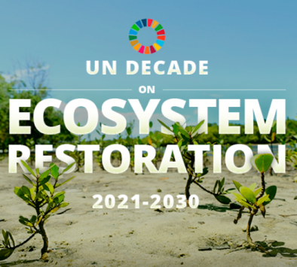
Strategic objectives 2018-2022
Mobilize political and financial support for the implementation of the Global Plan of Action on Forest Genetic Resources in the Asia-Pacific region
Make available information about the forest genetic resources in the Asia-Pacific region
Develop conservation and sustainable use strategies for regionally important and threatened tree species
Strengthen tree seed supply systems to facilitate ecosystem restoration, support local livelihoods and climate change adaptation and mitigation
www.apforgen.org
Notes:
The other objectives date from the previous strategy from 2014, but the second objective was added in the 2018 strategy based on a realisation that information is still widely lacking on that, and having it is necessary for achieving the other objectives 3 & 4

Slide 3
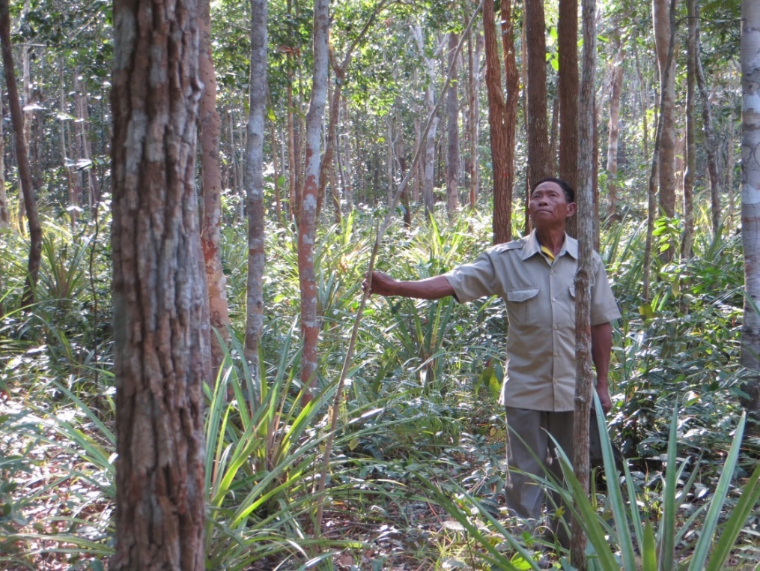



Darwin Initiative project:
Conserving Rosewood genetic resources for resilient livelihoods (2018-2021)
Cambodia, Lao PDR, Thailand, Vietnam & China
Guidelines and capacities for in situ and ex situ conservation and restoration
Improved seed quality and availability
Seed value chains for livelihood benefits
Notes:
Objective 3 / 4

Slide 4

APFORGIS: Establishing an Information System for conserving native tree species and their genetic resources in Asia-Pacific (2017-2019)
Regional gap analysis on the conservation status of 70 socio-economically important tree species
Seed zones identified to support restoration
Data sourcing, validation and regional priority setting with 40+ partners
Web tool for setting spatial conservation and restoration priorities
Capacity strengthening for applying methods to other species
Notes:
Objective 2

Slide 5
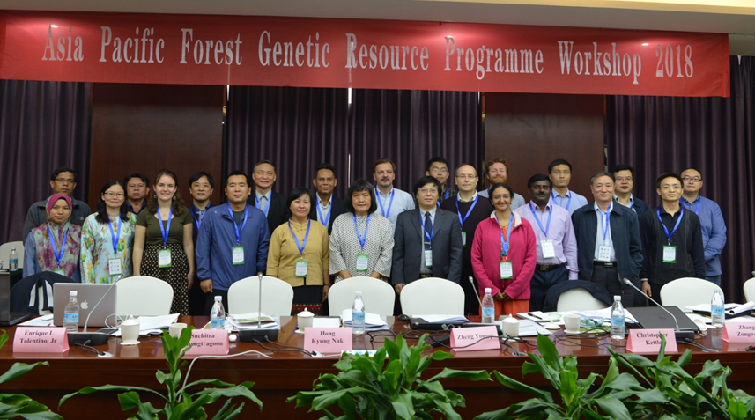

NSFC-CGIAR cooperation project:
Mapping genetic diversity of key species of Dalbergia in Asia and Pacific region (2018-2022)
Joint proposal by Chinese Academy of Forestry (CAF) and Bioversity International (BI), involving APFORGEN members including Thailand, Cambodia, Laos, Vietnam, Myanmar;
Mapping distribution and genetic diversity of key Dalbergia species in the region;
Exploring genomic information by high throughput sequencing;
Using Species Distribution Model (SDM) to identify causes for and diversity loss and potential threats to Dalbergia under climate change;
Developing conservation strategies for the selected Dalbergia species.

Slide 6
APFNet project
Joint proposal by CAF, BI, Philippines, Thailand, Sri Lanka
The proposal has been approved in the second round panel review, and requested for further improvement in the design of project activities
Reviewing past restoration projects to identify experiences and lessons learned from the successes and failures
Proposing best practices of restoration of degraded forestland in participating members

Slide 7
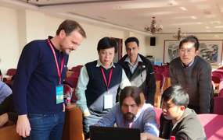
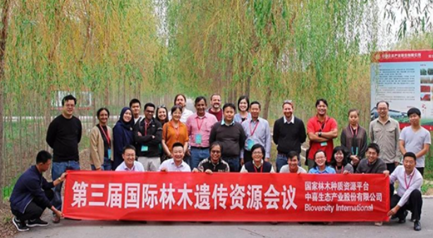
Regional Forest Genetic Resources training center
Established in 2015 by CAF and BI in collaboration with China Happy Ecology
3 training courses have been completed
Targeting capacity building of member countries in management, conservation and technologies for sustainable utilization of FGR
Inviting worldwide experts for lecturing at the training center
From theories to practices, and from conservation to utilization: case studies of conserving forest tree species
Uses of GIS platforms, Species Distribution Models for conservation

Slide 8
Future plan
The 4th training course to be held in October 2019, including
    Application of SDM and threat mapping
    GIS based information system on FGR
    Introduction to the SoW-FGR-2
    FGR forum by high-level governmental officials of member countries
Preparation of a 3-year plan for future APFORGEN activities
Continue to seek supports from various resources, including governments, private sector and donor agencies
Exploring opportunities for synergies between the regional networks

Slide 9
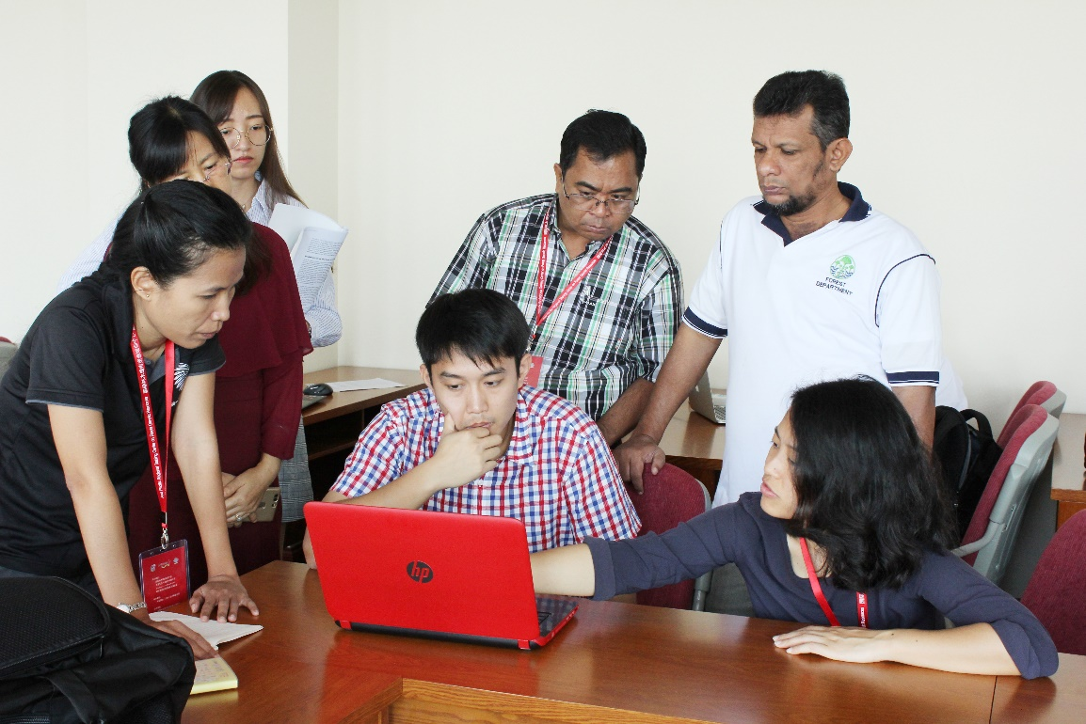
We welcome:
Information on FGR training needs for the training centre
Suggestions for targets and activities for the next workplan
In kind and other support for implementing activities in member countries
Collaboration to develop regional projects, organise meetings and workshops, and advocate for FGR in policy and planning processes

Slide 10
Acknowledgements
Many thanks are given to:
APFC organizers for invitation
Bioversity for providing travel support
Drs. Riina Jalonen, Christopher Kettle, Jarkko Koskela for contributions to the preparation of the presentation

Slide 11
Thank you!

